Slide 1
{Title}
{Text}
Notes:
Sunday Service Title

Slide 2
{Title}
{Text}
Notes:
Title Text

Slide 3
{Title}
{Text}
Notes:
Title Text (Compact)

Slide 4

{Title}
{Text}
Notes:
Prayer of Confession

Slide 5
THE LORD’S PRAYER
Our Father in heaven,
Hallowed be Your name.
Your kingdom come,
Your will be done,
On Earth as it is in heaven.
Give us this day our daily bread.
Notes:
The Lord’s Prayer PT 1

Slide 6
THE LORD’S PRAYER
And forgive us our debts,
as we also have forgiven our debtors.
And lead us not into temptation,
but deliver us from evil.
For Yours is the kingdom, the power,
the glory, forever.
Amen
Notes:
The Lord’s Prayer PT 1

Slide 7
HOLY COMMUNION
Notes:
Benediction

Slide 8
1 CORINTHIANS 11:23-29
²³ For I received from the Lord what I also
delivered to you, that the Lord Jesus on the
night when he was betrayed took bread,
²⁴ and when he had given thanks, he broke it, and
said, “This is my body, which is for you. Do
this in remembrance of me.”
Notes:
Holy Communion Verses PT 1

Slide 9
1 CORINTHIANS 11:23-29
²⁵ In the same way also he took the cup, after
supper, saying, “This cup is the new covenant in
my blood. Do this, as often as you drink it, in
remembrance of me.”
²⁶ For as often as you eat this bread and drink the
cup, you proclaim the Lord’s death until he
comes.
Notes:
Holy Communion Verses PT 2

Slide 10
1 CORINTHIANS 11:23-29
²⁷ Whoever, therefore, eats the bread or drinks
the cup of the Lord in an unworthy manner
will be guilty concerning the body and blood
of the Lord.
²⁸ Let a person examine himself, then, and so eat
of the bread and drink of the cup.
²⁹ For anyone who eats and drinks without
discerning the body eats and drinks judgment
on himself.
Notes:
Holy Communion Verses PT 3

Slide 11
APOSTLE’S CREED
I believe in God, the Father almighty, the creator of heaven and earth. I believe in Jesus Christ, his only Son, our Lord, who was conceived by the Holy Spirit and born of the virgin Mary. He suffered under Pontius Pilate, was crucified, died, and was buried; he descended to hell. The third day he rose again from the dead.
Notes:
Apostle’s Creed PT 1

Slide 12
APOSTLE’S CREED
He ascended to heaven and is seated at the right hand of God the Father almighty. From there he will come to judge the living and the dead. I believe in the Holy Spirit, the holy catholic church, the communion of saints, the forgiveness of sins, the resurrection of the body and the life everlasting. Amen.
Notes:
Apostle’s Creed PT 2

Slide 13
{Title}
{Text}
Notes:
Sermon Title

Slide 14
OFFERING
“Each of you should give what you have decided in your heart to give, not reluctantly or under compulsion, for God loves a cheerful giver.”
—2 Corinthians 9:7
Notes:
Offering

Slide 15
DOXOLOGY
Praise God, from whom all blessing flow
Praise Him, all creatures here below
Praise Him above, ye heavenly hosts
Praise Father, Son and Holy Ghost
Amen
Notes:
Doxology

Slide 16
BENEDICTION
Notes:
Benediction

Slide 17
NEXT WEEK’S SCHEDULE
 | {Date}
Speaker | {Speaker}
Worship Leader | {Leader}
Accompanist | {Accompanist}
Streaming | {Streaming}
Announcer | {Announcer}
Notes:
Next Week’s Schedule

Slide 18

{Title}
{Text}
Notes:
Hymn 1

Slide 19
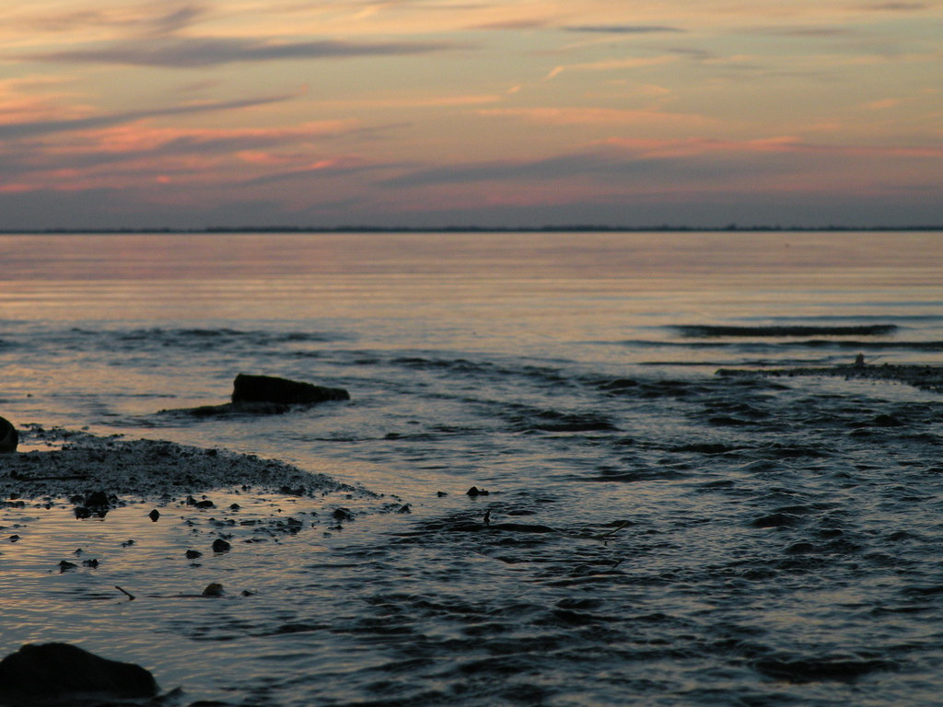
{Title}
{Text}
Notes:
Hymn 3

Slide 20

{Title}
{Text}
Notes:
Hymn 2

Slide 21

{Title}
{Text}
Notes:
Hymn 4

Slide 22

{Title}
{Text}
Notes:
Hymn 4

Slide 23

{Title}
{Text}
Notes:
Hymn 4

Slide 24

{Title}
{Text}
Notes:
Hymn 4

Slide 25

{Title}
{Text}
Notes:
Hymn 4

Slide 26
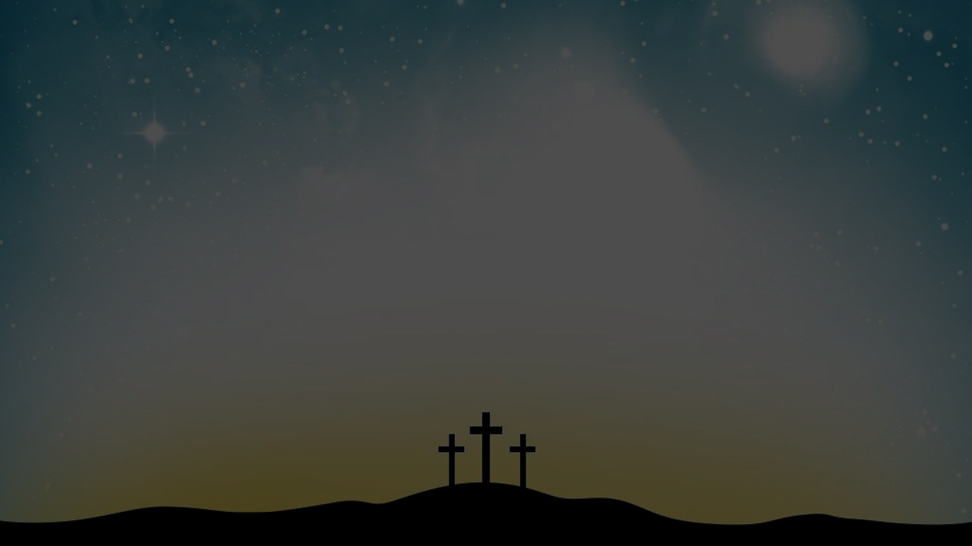
{Title}
{Text}
Notes:
Hymn 4

Slide 27
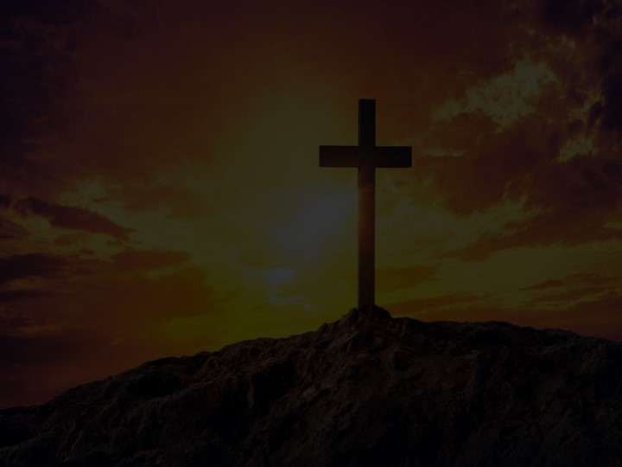
{Title}
{Text}
Notes:
Hymn 4

Slide 28

{Title}
{Text}
Notes:
Hymn 4

Slide 29
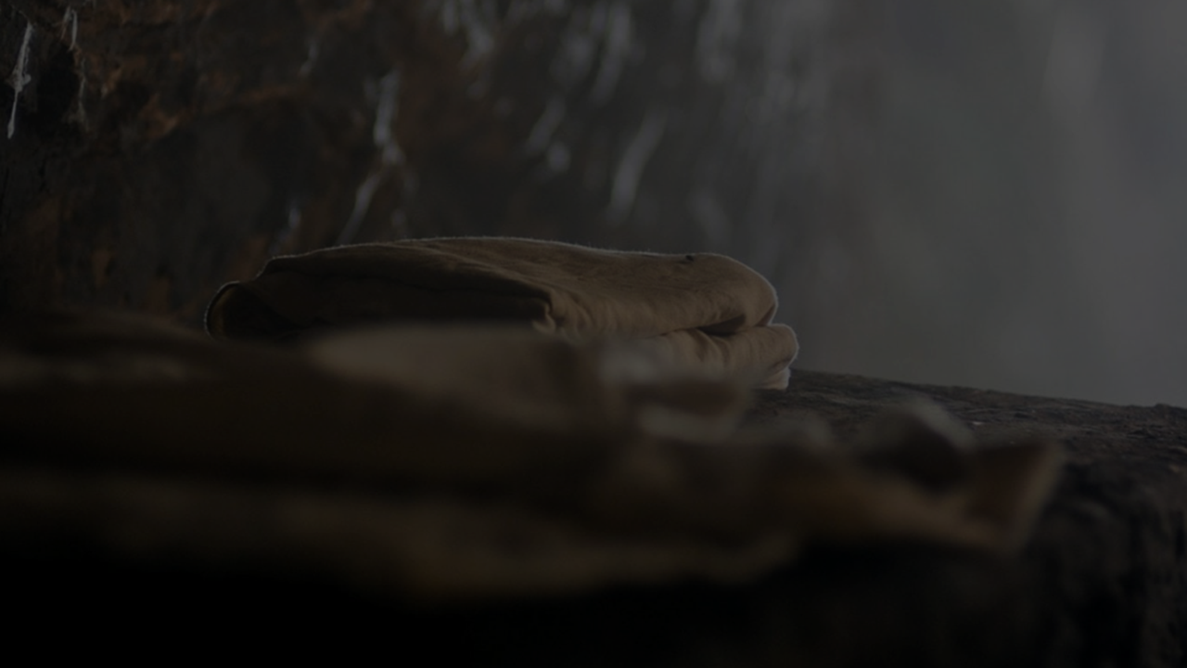
{Title}
{Text}
Notes:
Hymn 4

Slide 30

{Title}
{Text}
Notes:
Hymn 4

Slide 31
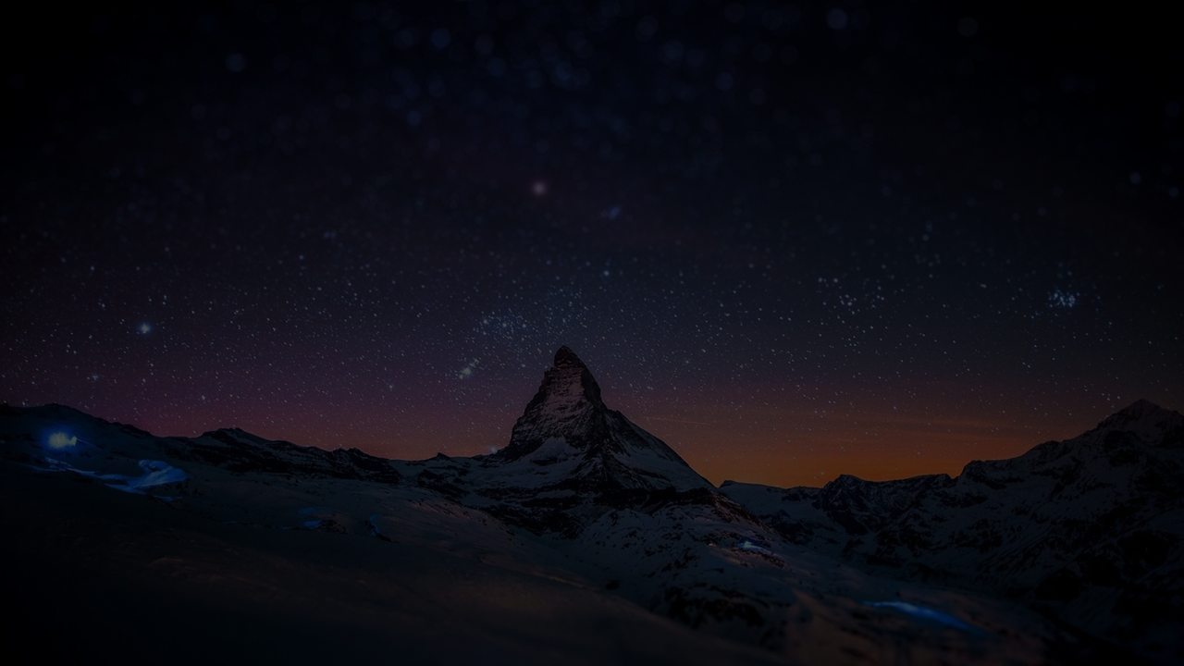
{Title}
{Text}
Notes:
Hymn 4

Slide 32
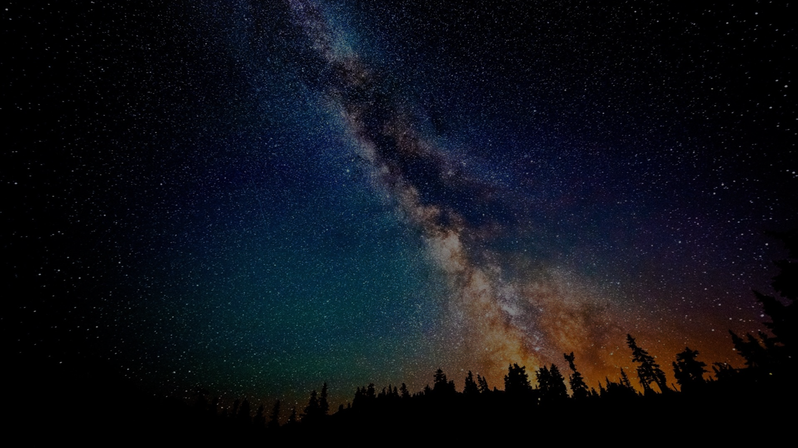
{Title}
{Text}
Notes:
Hymn 4

Slide 33
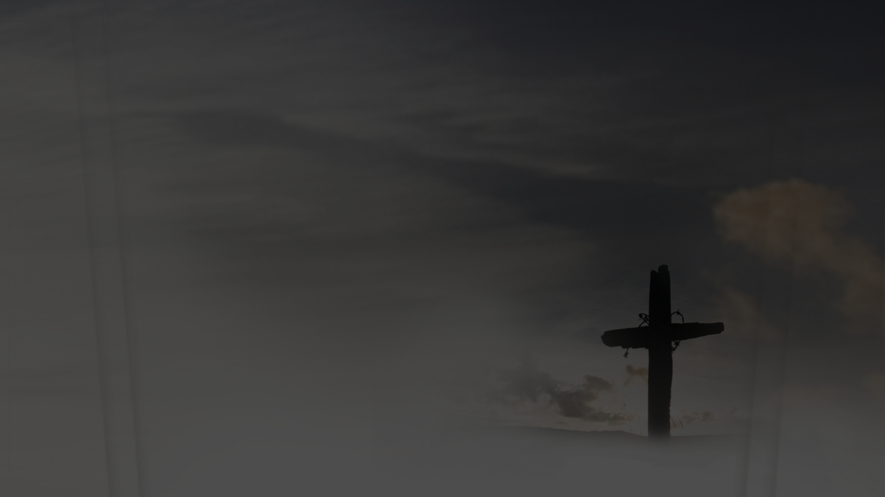
{Title}
{Text}
Notes:
Hymn 4

